Slide 1
Opiates and Overdoses, Oh My! Indications for BLS use of IN Naloxone
David C. Leisten, BA, CCEMT-P, CIC
Jeremy T. Cushman, MD, MS, EMT-P
Eric D Rathfelder, BS, EMT-P

Slide 2
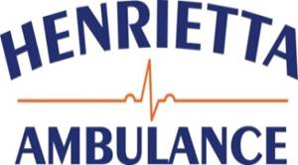
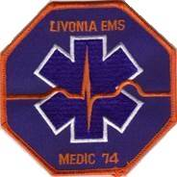
This educational program is made possible in part by the following

Slide 3
Purpose
The purpose of this program is to educate the BLS provider to the inclusion of Naloxone into the EMT medication formulary

Slide 4
Objectives
At the conclusion of this program the BLS provider will be able to:
Identify the signs, symptoms, and considerations for possible opiate OD
Understand the basic pharmacology of Naloxone
Understand the indications and administration of IN Naloxone

Slide 5
Outline
Discuss the premise for the inclusion into the BLS formulary
Opiates and overdoses
Pharmacology of Naloxone
Administration of IN Naloxone
Case review

Slide 6
Premise
In October 2013, New York State Department of Health – Bureau of EMS approved the use of Naloxone (Narcan) by Basic Life Support providers and has been included in the scope of practice by EMTs for the management of patients with opioid overdose.

Slide 7
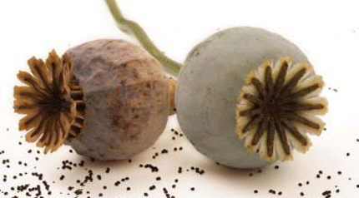
Opiates and opioids

Slide 8
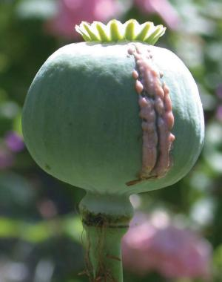
‘Opioids’ - a term used interchangeably to describe both:
Opiate - Natural narcotic analgesic derived from an opium poppy
Opioid - Synthetic narcotic analgesic with similar properties as opiates. Similar molecular composition.

Slide 9
Controlled Substances
Opioids fall under the Controlled Substances Act and are further classified into ‘Schedules’ ranking medications based off of validity in medical use and abuse potential

Slide 10
Schedule I
No current medical use in the USA
High potential for abuse
Schedule II
High potential for abuse and may result in physical and psychological dependency
Schedule III
Less potential then I & II, and abuse may lead to low physical dependence or high psychological
Schedule IV
Lower potential then III
Schedule V
Lower then potential then IV. Includes preparations of medications with limited narcotic composition

Slide 11
Common Opioids
Opiates
Opioids
Heroin
Morphine
Codeine
Opium
Dilaudid (Hydromorphone)
Demerol (Meperidine)
Methadone
Hydrocodone
Fentanyl
Suboxone
Percocet
Vicodin
Not Opioids
Xanax
Cocaine
Methamphetamines
Valium
Notes:
Discuss important points of:
Pills can be extended release or long acting compared to heroin
Methadone clinics and use of methadone
Suboxone uses, limits, and abuse
Fentanyl patches
Morphine named for Morpheus – Greek god of sleep

Slide 12
Mechanism of Action
Act on Opioid receptors within the CNS
Three primary receptor sites
Physiological response depends on the receptor site affected
Primary actions:
Analgesic properties
And
Sedative properties
Notes:
The primary indication of opioids is the management of patients with acute and chronic pain. Patients may be prescribed narcotic medication to manage these symptoms, but aside from Analgesia opioids have sedative properties as well.
Provides analgesic effects by increasing the pain threshold necessary to induce a response.
Sedative effects is caused by inhibiting signals at the brain stem level

Slide 13
Side Effects
Altered/decreased mental status
Decreased respiratory rate
Hypoxia
Hypercarbia
Constipation
Nausea
Death caused by respiratory arrest
Notes:
Side effects of opioids vary from patient to patient, but may include some, if not all of the following:
AMS, Decreased RR which ultimately may lead to hypoxia, hypercarbia, respiratory arrest and ultimately cardiac arrest.
Nausea/constipation d/t action on the GI tract. Prolonged use of opioids results in decreased motility of the GI tract as well as

Slide 14
Opioid Epidemic
The United States
Notes:
So, why some of the changes and inclusion into the BLS formulary? Not only is it a procedure that requires little to no ‘advanced training’, but it Opioid overdoses is an epidemic that has been increasing exponentially within the past few years.
NY state, among many others has adopted programs to provide Naloxone to at risk populations.
The benefits of administration outweigh the risks at these times.

Slide 15
Who is at risk?
People who use opioids for pain control | Young people who are experimenting with drugs or who have drug dependence | Long time drug users, often after a period of abstinence (rehab, prison, recovery)
Opioid overdoses occur in urban, rural and suburban areas of the state

Slide 16
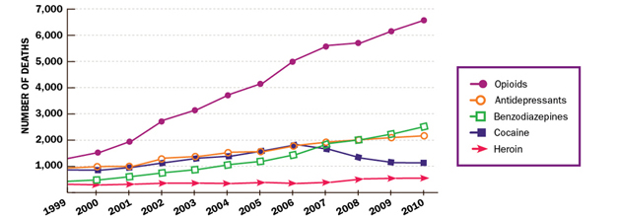
Prescription Overdose Deaths Among Women
SOURCE: National Vital Statistics System, 1999-2010 (deaths include suicides)
Notes:
Reviewing data only among women within the last 11 years we see the increasing amount of OD deaths from both prescribed medications and common recreationally abused forms.
Opioids have significantly greater amounts of deaths associated then all others.

Slide 17
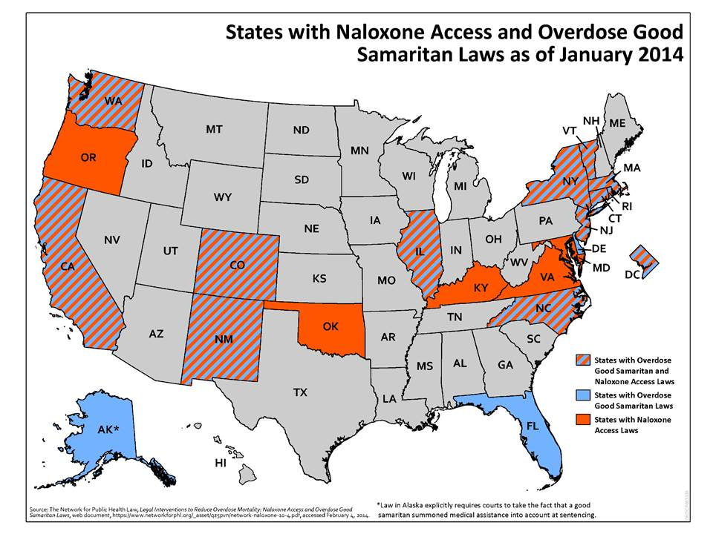
Notes:
Due to increasing numbers of overdoses on both recreational and prescribed opioids states have developed programs to try and reduce number of OD related deaths.
New York state is among several that has adopted Narcan programs for at risk populations.

Slide 18
Notes:
# of deaths has been increasing exponentially since 1999

Slide 19
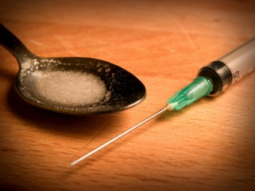
Overdose Potential
Opiate/opioid medications, because of analgesic effects, have high potential for overdose
Intentional
Accidental
Recreational
Notes:
Because of the nature of the medication and the variety of uses there exists substantial potential for abuse with this medication. However, abuse and potential for overdose will vary.
Overdoses may be:
Accidental – use for pain management may cause patient’s to exceed recommended doses to manage their chronic pain resulting in creased doses and accidental OD as tolerance levels change
Potentiation of medications
Decline of physical health
Liver function decline
Weight loss
Intentional – Opiates result in resp. depression, sedative, and analgesia. Because of its actions is often associated with suicidal attempts.
Recreational – Heroin has existed for decades and originally used for analgesia. Because of its effects and potency is a common recreational street drug. Because of its availability on the streets and no control over its ‘purity’ often results in recreational OD and most likely reason EMS administers Naloxone. Polypharmacy often occurs because of the multitude of medications consumed for recreational purposes.

Slide 20
Intentional Overdoses
Pharmacological assisted suicides
Opioids have been commonly used in conjunction with other prescribed medications as means to inflicting self harm

Slide 21
Accidental Overdoses
Because of the use in management of chronic pain opioids are associated with accidental overdoses
Prolonged discomfort results in tolerance to medication requiring increased dosing
Interactions with other prescribed medications

Slide 22
Accidental Overdoses
Potentiated by other medications
Changes in metabolism and intolerance to medication
Geriatrics and nursing home patients are more susceptible to these complications

Slide 23
Recreational Overdoses
Because of the nature of the mediations and euphoric effects associated with them opioids have high abuse potential
Polypharmacy
‘Speedball’
No regulatory control over illegal substances like heroin to control the ‘purity’

Slide 24
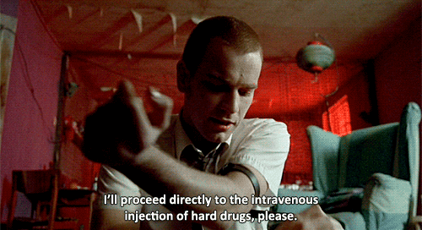
- Trainspotting, 1996
Notes:
Many people actually snort heroin

Slide 25
Opioid Overdose Triad
Respiratory Depression
Altered Mental Status
Pinpoint Pupils

Slide 26
Overdose Signs and Symptoms
Euphoria
Hypotension
Bradycardia
Bradypnea
Hypothermia
Diminished respiratory effort
Drowsiness
Respiratory arrest
Pupil constriction
Injection ‘track’ marks
Cardiac arrest
Cyanosis
Vomiting

Slide 27
Differentiating Toxidromes
Opioid/Narcotic
Sedative/Hypnotic
CNS depression AND respiratory depression and miosis
There are other medications that will cause these symptoms.
Sedation with CNS depression and minimal or no respiratory depression and miosis or mydriasis
Anticonvulsants, benzodiazepines, barbiturates, ethanol, methocarbamol, trazodone, zolpidem, designer benzo’s, ketamine, MXE

Slide 28
Additional EMS Concerns
Intravenous drug users are at increased risk for infectious diseases such as hepatitis and HIV/AIDS
There may be needles on the patient
Rapid withdrawl from overdose can lead to disorientation and, occasionally, combativeness (more on this later)
Notes:
While overdoses are not limited to IV/recreational drug users, they will be some of the most common. As seen in the news within the previous months there have been an increasing number of heroin associated deaths. IV drug users are notorious for additional health concerns such as those listed above. And and because of the impurity/cutting with other substances result in inefficient immune systems and likely to have multiple communicable and infectious disease.
Because of this, IN administration, which will be later discussed is an ideal and safe means for treating these patients, not having to be concerned with potential for accidental needle sticks.

Slide 29
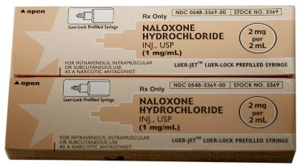
Naloxone
Name: Naloxone Hydrochloride (Narcan)
Class: Opioid Antagonist
Action: Reverses effects of opioids
Availability: 2mg/2mL

Slide 30
Naloxone
Competitive antagonist that can reverse opioid OD
May require more than 1 dose if no effect in 3-5 mins
Low risk of harmful side effects (including in patients
who are not suffering opioid OD)
Dose: 2 mg, IN (1 mg/nare)
Notes:
Consider discussing poly pharmacy concerns here (“speedballing”

Slide 31
Opioid receptor
Opioid bound to receptor site
- Harm Reduction Coalition
Notes:
Base image from Harm Reduction Coalition

Slide 32
Naloxone bound to receptor site
Notes:
Naloxone acts competitively with receptor sites, displacing opioids bounds, temporarily reversing OD

Slide 33
Side Effects
Nausea
Vomiting
Combativeness
Agitation
Diarrhea
Hypertension
Tremors
Tachycardia
Diaphoresis
Dilated pupils

Slide 34
By the Numbers
400 – number of regional BLS administrations
10% - approximate incidence of uncooperative patients post-administration
2 – number of patients requiring mechanical restraints
0 – number of first responders injured
Notes:
Uncooperative patients are analogous to D50 wakeup or postictal patients.
Patients need to be reoriented and talked with about what is going on.

Slide 35
EMS Care
Remember the basics:
Perform patient assessment and history taking
Routine patient care and airway management
High flow O₂ and/or assist ventilations
Then:
3) If unresponsive with respiratory depression and possible opiate overdose:
Administer Naloxone
Notes:
Discuss appropriate assessment of these patients and options for interventions and management of these patients prior to proceeding to IN medications.

Slide 36
When to Use Naloxone
Overdose suspected
Not responsive to painful stimuli
Breathing status
Normal or Fast
Slow
No or Gasping
Appropriate care
Assisted ventilations and Naloxone
Cardiac arrest protocol and Naloxone

Slide 37
Intranasal (IN)
Alternate route for administration of medications that are absorbed in the blood
Comparable rates of absorption with IV/IO administration
Increased safety
Needleless
Painless
Notes:
Frequently used in the out of hospital setting by PCP office as route of flu vaccines as well as OTC medications

Slide 38
Naloxone Administration
Each package contains one 2mg/2mL vial
Remove caps on delivery system and medication vial
Connect mucosal atomization device (MAD)
Insert medication into delivery system
Administer 1mg/nare
- Harm Reduction Coalition

Slide 39
Steps to assemble – Open box
Notes:
For equipment, you will need one luer-jet needle free syringe, one vial of naloxone, and one atomizer.

Slide 41
take off yellow caps
Notes:
For equipment, you will need one luer-jet needle free syringe, one vial of naloxone, and one atomizer.

Slide 42
take cap off medication
Notes:
For equipment, you will need one luer-jet needle free syringe, one vial of naloxone, and one atomizer.

Slide 43
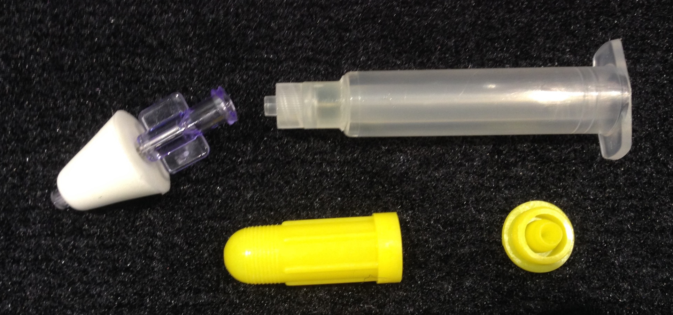
open atomizer
Notes:
For equipment, you will need one luer-jet needle free syringe, one vial of naloxone, and one atomizer.

Slide 44
attach atomizer
Notes:
For equipment, you will need one luer-jet needle free syringe, one vial of naloxone, and one atomizer.

Slide 45
screw medication into holder
Notes:
For equipment, you will need one luer-jet needle free syringe, one vial of naloxone, and one atomizer.

Slide 46
Administration Considerations
While indicated for management of opioid overdose, patients dependent on medications for management of symptoms may experience symptoms of withdrawal
Remove all prescription patches prior to administration
Caution with patients known to mix recreational drugs
> 1 mL may cause ‘run off’
Poor and/or no absorption with vasoconstriction of the nares, epistaxis, and mucus discharge

Slide 47
Administration Considerations
When administering, hold patient’s head with one hand and carefully direct MAD in a POSTERIOR direction NOT towards the top of the head.
Squeeze the syringe hard enough to atomize the medication
Law enforcement or FD may have access to naloxone
Patient should be transported to the hospital after administration. Collaborate with law enforcement for MHA if necessary.

Slide 48
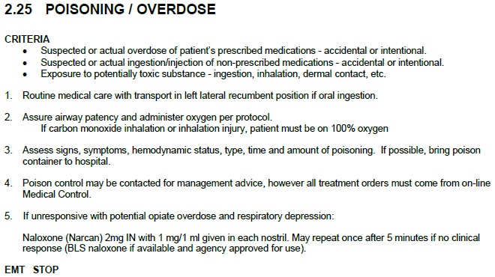

Slide 49
Patient Care
Translation to

Slide 50
Scenario 1
36 year old female
Husband finds her difficult to arouse
GCS of 1 / 3 / 4
Groans and withdraws slightly to painful stimuli
Treatment plan?
Considerations?
Notes:
Per family patient has no hx. of substance abouse
Chronic pain and uses fentanyl patches

Slide 51
Scenario 1
HR 62 and regular
RR 8 and shallow w/ snoring respirations
BP 100/60
SPO₂ 89%
Treatment plan?
Notes:
Physical assessment of patient finds multiple fentanyl patches, 6, placed about her body.
Pinpoint pupils on exam
Discuss options of administering Nalxone vs. routine BLS interventions and high flow O2
Emphasis on BLS procedures prior to immediate Naloxone treatment – repositioning the airway stops snoring respirations and rate improves slightly as does effort
High flow O2
SPO2 improves with repositioning and supplemental O2
Any stimulus begins to make patient more arousal
Remove Fentanyl patches – how to appropriately dispose of?

Slide 52
Scenario 2
19 year old male
Roommate request EMS after finding him unresponsive in his room

Slide 53
Scenario 2
Unresponsive
Pinpoint pupils
Apneic and cyanotic
HR of 46
Notes:
Recap appropriate management and discuss the side effects that come with administration
IN Naloxone w/ routine BLS airway management
Recap the common symptoms and presentations of OD patients, Bradycardia, hypotension, apnea
Discuss the concerns of potential combination of street drugs, heroin/cocaine – concerns for reversing one, not knowing what patient’s use patterns area.

Slide 54
Summary

Slide 55
Summary
Naloxone has been approved by New York Department of Health and included within the EMT formulary
EMTs, with the approval of the Agency Medical Director, may carry and administer naloxone for suspected opiate overdose

Slide 56
Summary
‘Opioids’ is a term used to classify drugs synthetically and naturally produced from the poppy
Overdoses and deaths associated with opioid overdoses have grown exponentially over the last 10 years
Suspicion of opioid overdoses should not be limited to recreational drug use of heroin, but abuse and chronic use of prescribed opioids

Slide 57
Summary
Chronic use of prescribed opioids may lead to dependence and result in withdrawal symptoms if naloxone is utilized
Intranasal (IN) administration serves as a fast and safe route of administration
Naloxone administration should be in conjunction with routine BLS care and airway support, not as an alternate to it

Slide 58
Summary
Naloxone is packaged as a 2mg/2mL prefilled syringe
Administer IN via MAD, 1mg per nares
Repeat once after 5 minutes if no clinical response

Slide 59
When to Use Naloxone
Overdose suspected
Not responsive to painful stimuli
Breathing status
Normal or Fast
Slow
No or Gasping
Appropriate care
Assisted ventilations and Naloxone
Cardiac arrest protocol and Naloxone

